Slide 1
G D 2 1 0
Game Studio - Prof. Alec McClure

Slide 2

INTRODUCTIONS

Slide 3


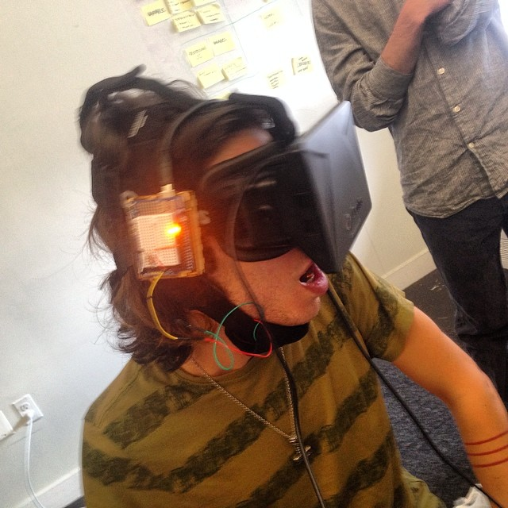
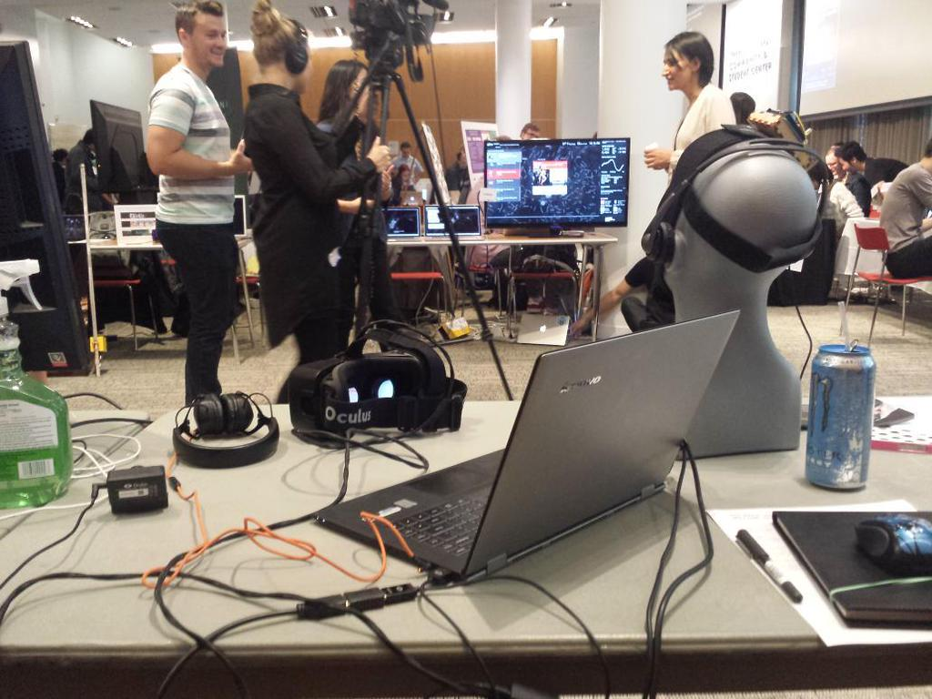
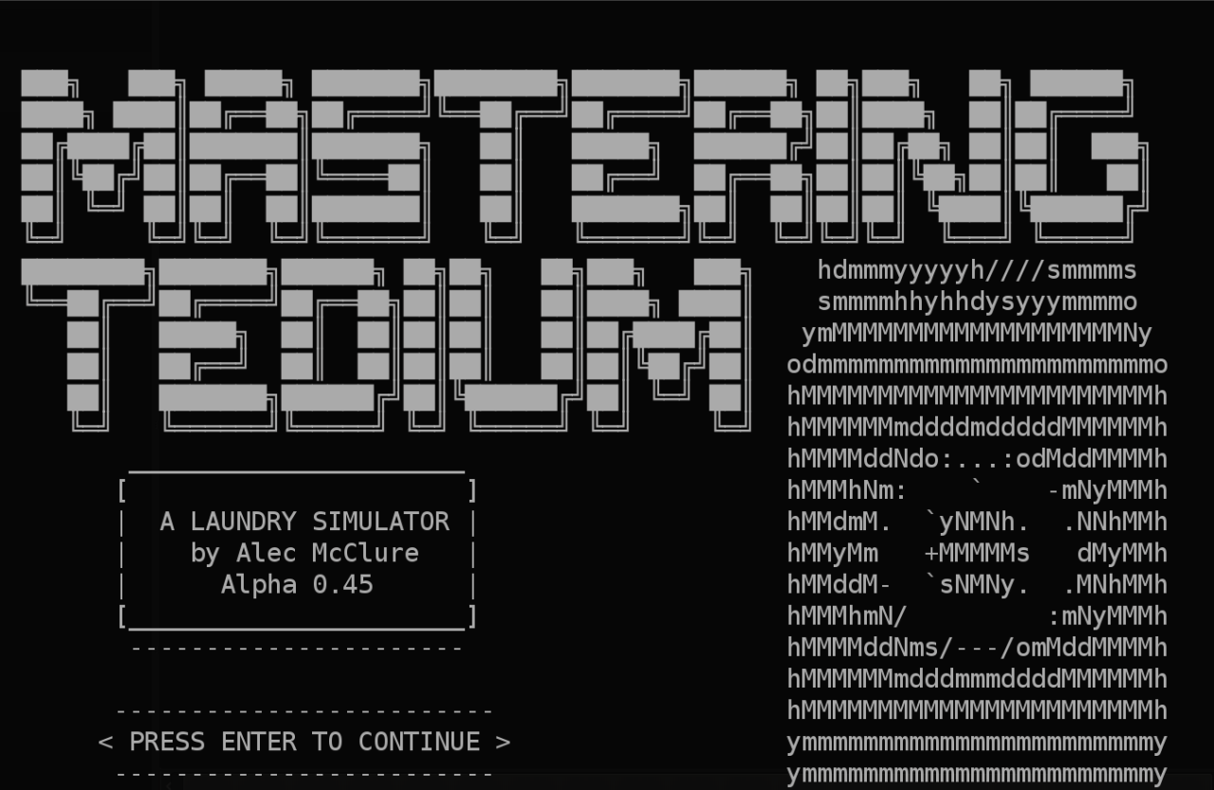
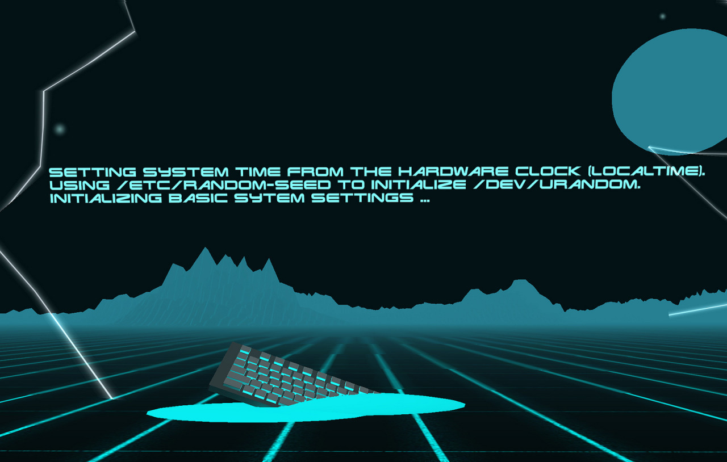
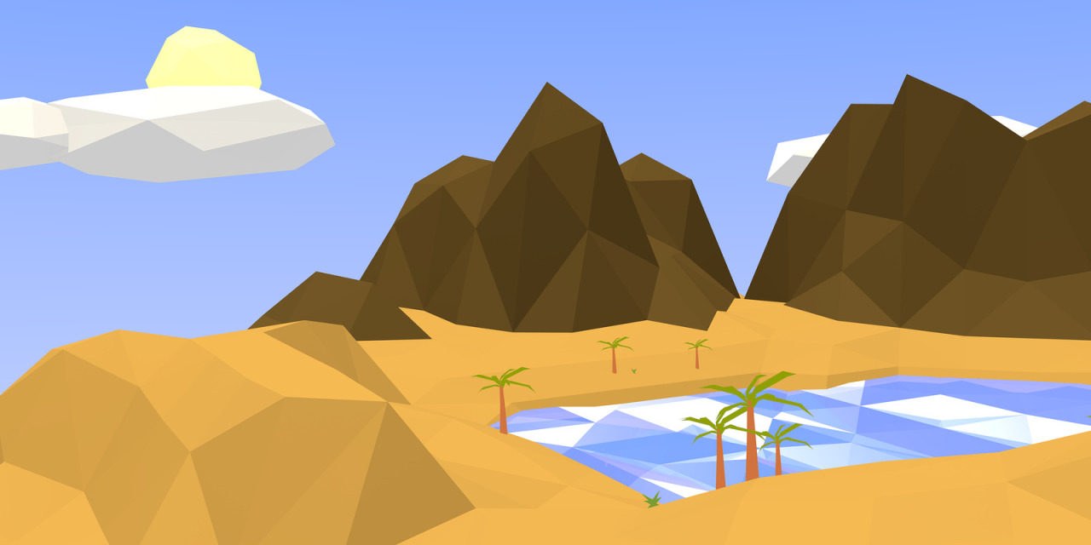
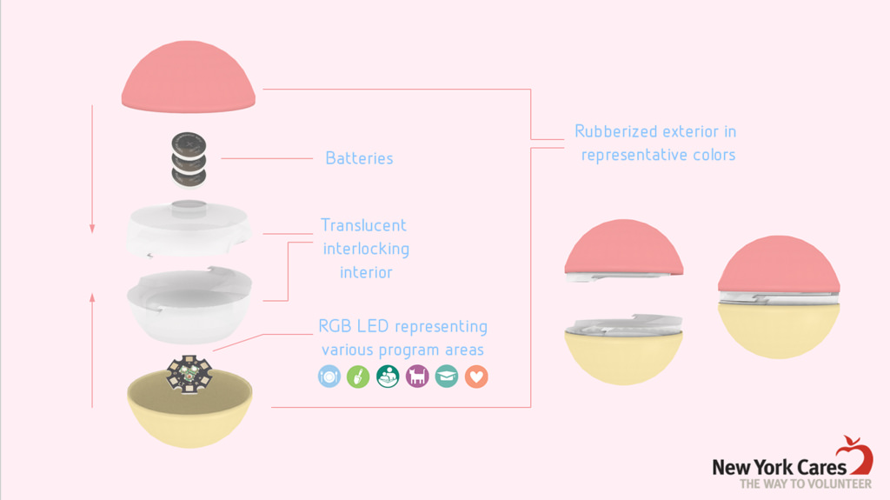
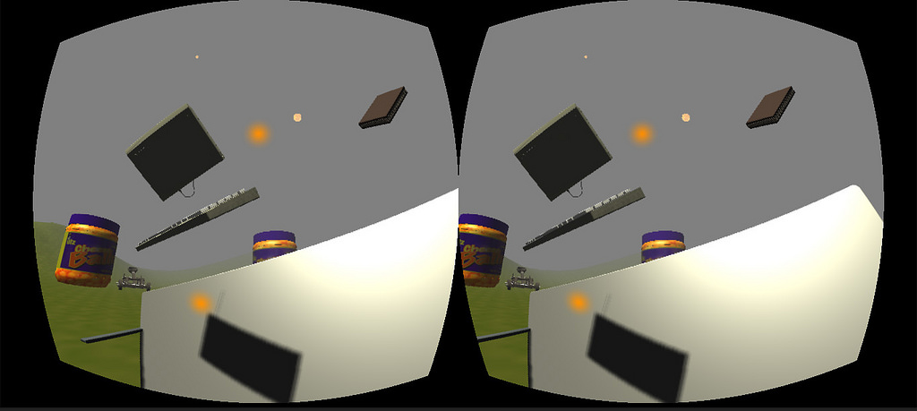
What do I do?
Notes:
i make games, interactive experiences
also professional experience in web design adn development and as photographer
a lot in vr lately

Slide 4
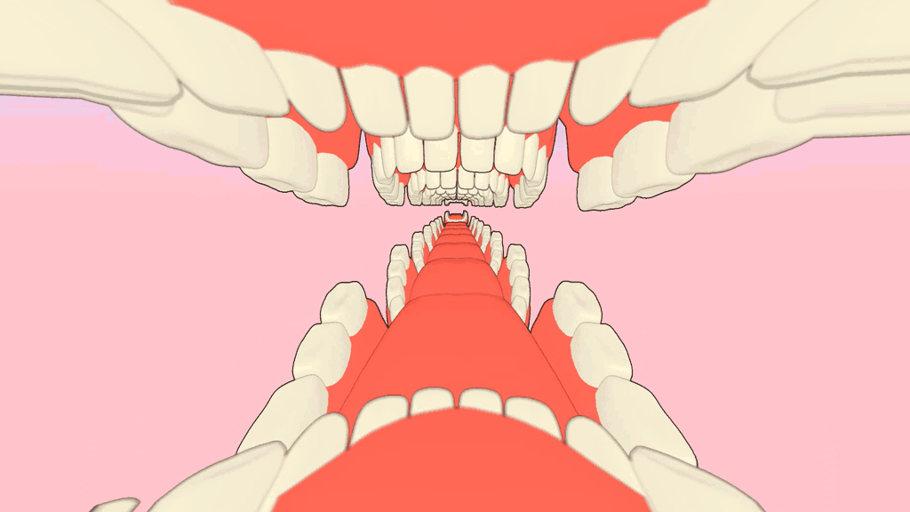
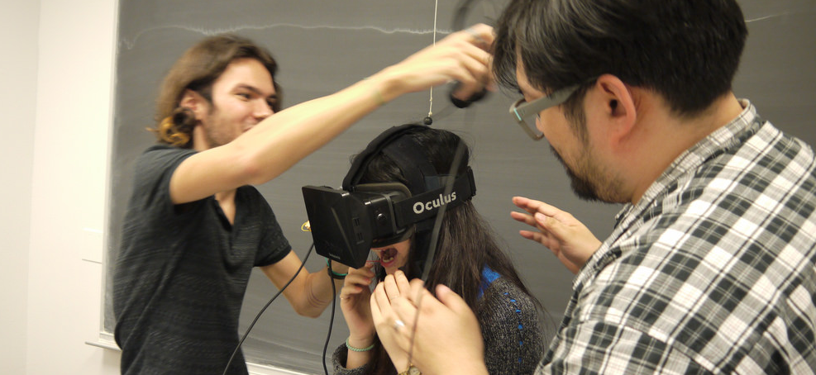

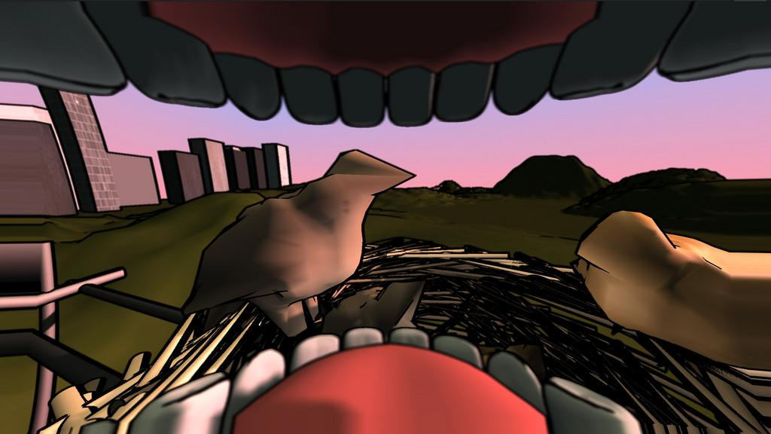
Notes:
puts you inside your mouth, looking out

Slide 5
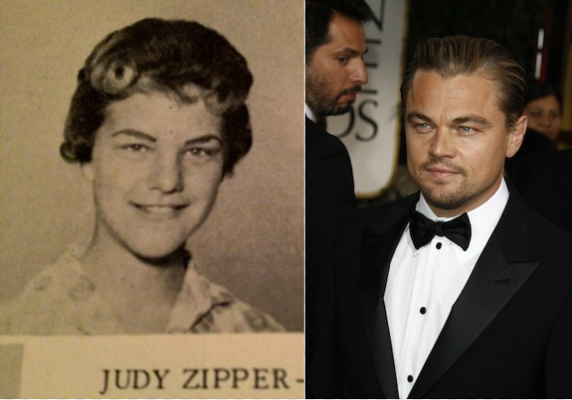
Name?
What do you want out of this class?
What game(s) did you play most over the break? Why?
What do you expect from this class?
Would you rather…?
Go 2000 years into the past to meet your ancestors?
Go 2000 years into the future to meet your descendents / witness the post-apocalypse?

Slide 6
SYLLABUS
link

Slide 7


Slide 8

http://hostosmdp.ryver.com
Download the app to your phone (for Android and iOS)

Slide 9
GD210 Ryver Tips & Guidelines
Your username is up to you, but you must use your first and last name as your display name. This is the only way you will get credit for your posts.
A recap of each week will be posted as a sticky to the team. Check it if you need to review the assignment or slides from the past week.
Make sure your homework posts go in the private team “S18 - GD210 Game Studio” as COMMENTS for the appropriate week’s topic.
Chat with other game design students in other classes in the “Hostos Game Design” open forum
Feel free to create private teams with your peers for group projects or just to chat.
If you feel lost about how to do something in Ryver, they’ve created tutorials on YouTube that will walk you through the process.

Slide 10

GAME
4
STAGES OF
DEVELOPMENT
GD210

Slide 11
GAMES
GAMES
GAMES
Notes:
are you interested in game development? whats your favorite game?

Slide 12
what is game
development ?
“Game development is the process of creating a game. Development is undertaken by a game developer, which may range from one person to a large business.”
Notes:
dev/publisher relationship

Slide 13
GAME DEVELOPMENT
AS A
4 STAGE PROCESS
QA
PRODUCTION
PRE-PRODUCTION
CONCEPTUALIZATION
Notes:
game dev broken

Slide 14
CONCEPT
FIRST!
Changing this is easy
QA
PRODUCTION
PRE-PRODUCTION
Changing this is hard
CONCEPTUALIZATION

Slide 15
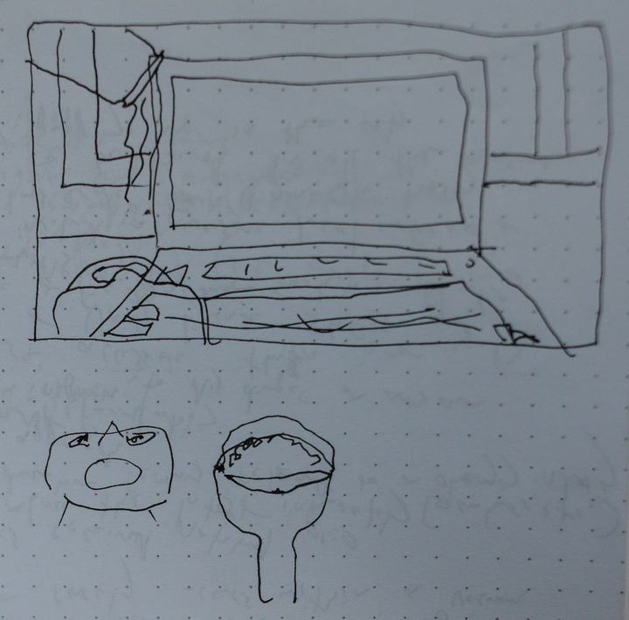
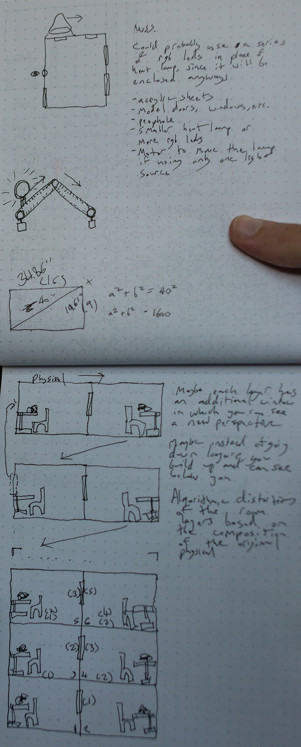
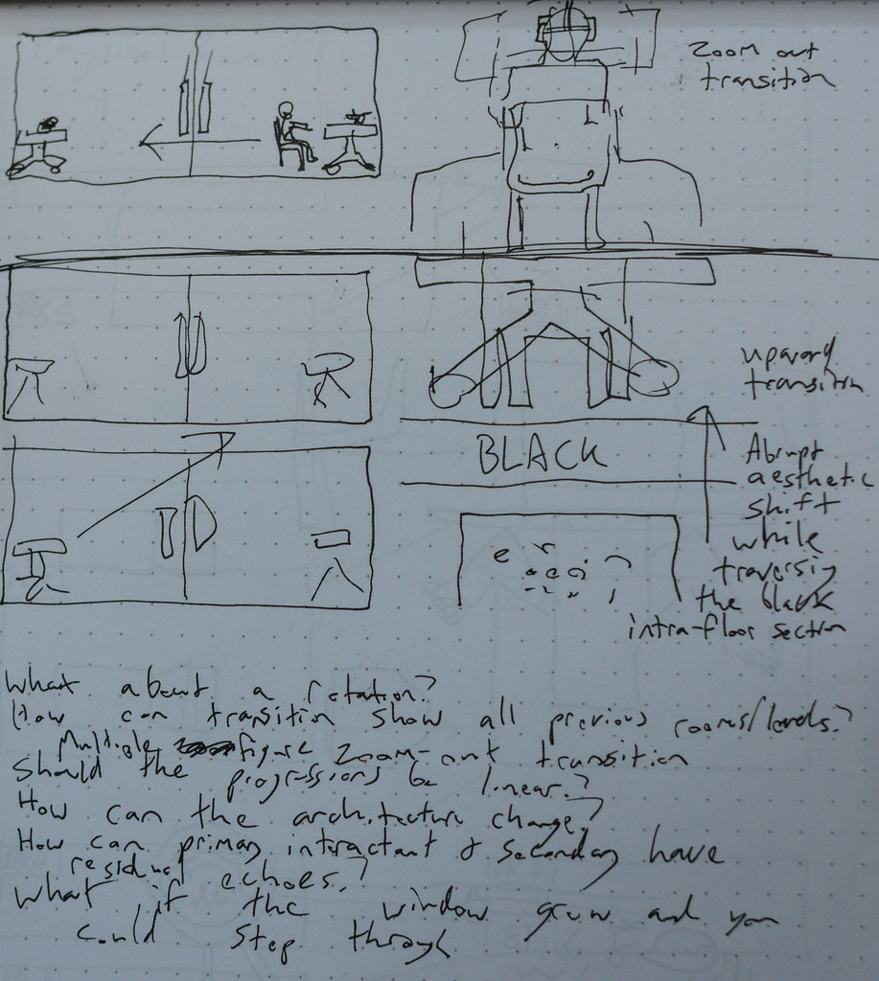
CONCEPTUALIZING
Clarify concept, narrative, feel, and mechanics
What does the game feel like?
What are the key interactions?
Why should people play it?
Design document(s), Team consensus
big sweeping changes?
MAKE THEM NOW!
Notes:
everything started with an idea
be able to communicate the concept clearly with others
be able to articulate what it is

Slide 16
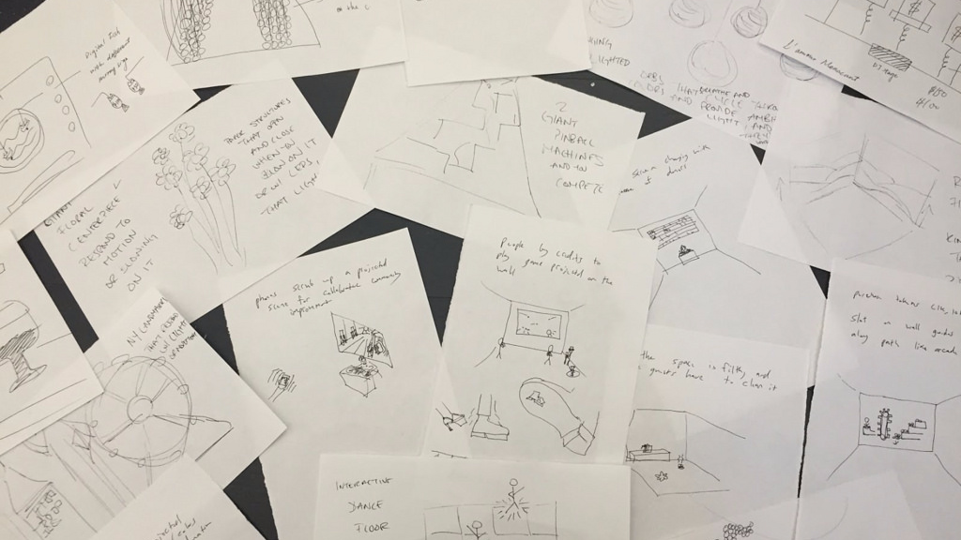
Brainstorm
Bodystorm
Storyboard
Mindmap
Moodboard
Notes:
i like to cut up paper and set a timer for 5 minutes to create 100 ideas

Slide 17
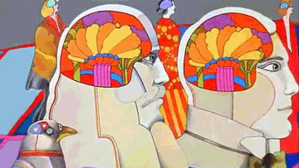
IDEAS DESERVE
TO BE FREE
Notes:
during the brainstorming process, go nuts. take idea as far as you can

Slide 18
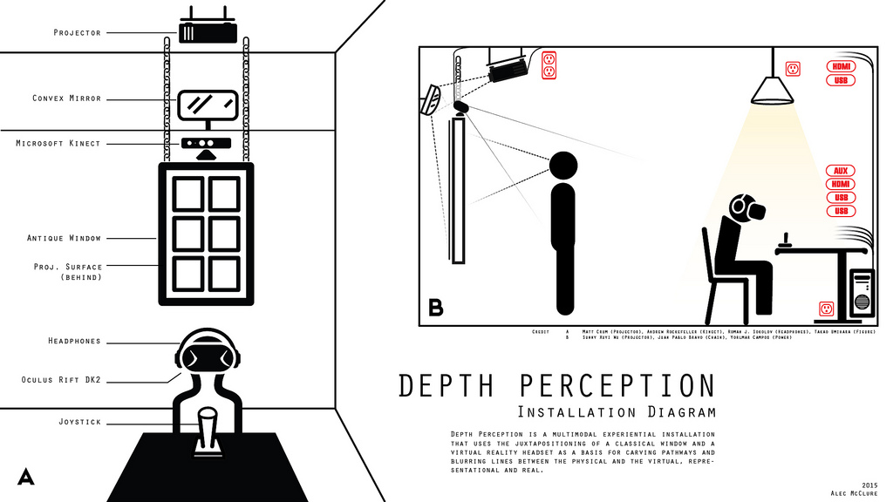
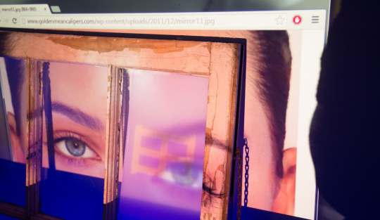
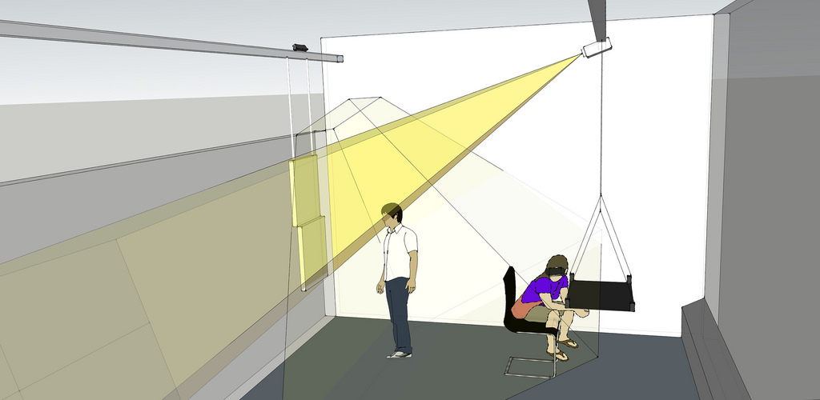
2.Pre-production
Planning and designing the implementation
Majority of design work in this phase
Begin prototyping materials, tools, mechanics, and technologies.
(digital and analog)
Notes:
prototype specific aspects like a specific functionality or look

Slide 19
Practical planning
What skills are necessary?
Whose expertise do you need?

Slide 20
Iterative Design
Prototype
Refine
Playtest
Analyze
Notes:
useful methodology
-make sure things work
-user/player-centric

Slide 21
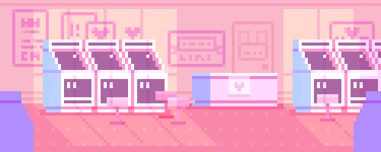
Where does
your game ‘live’?
Notes:
what framework will you use where does this game ‘live’ ? unity, tabletop, game console, physical game like tag

Slide 22
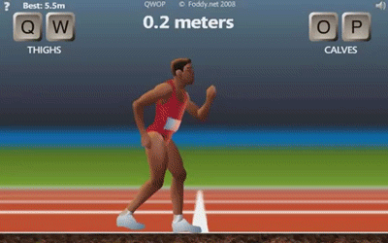
QWOP
link
Control Mechanic as Game Concept
Notes:
Without regular testing of whether the mechanic works, the entire premise could be flawed
TEST YOUR ASSUMPTIONS

Slide 23
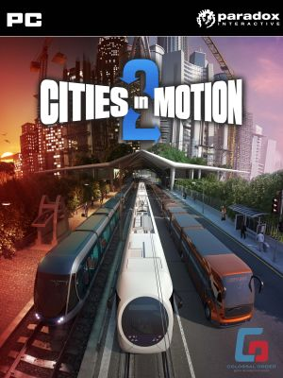
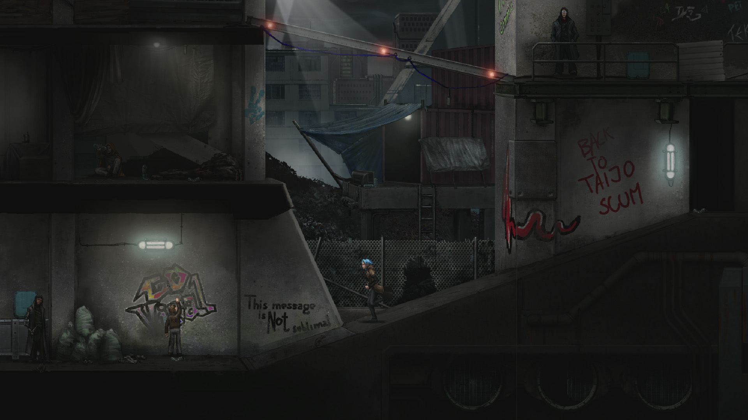


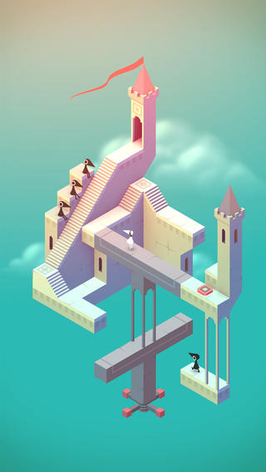
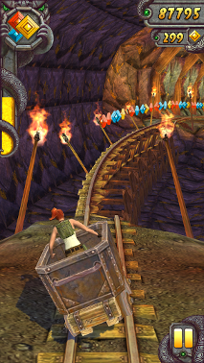
Multiplatform
2D and 3D
C#; Javascript
Notes:
temple run, monument valley
indie games

Slide 24

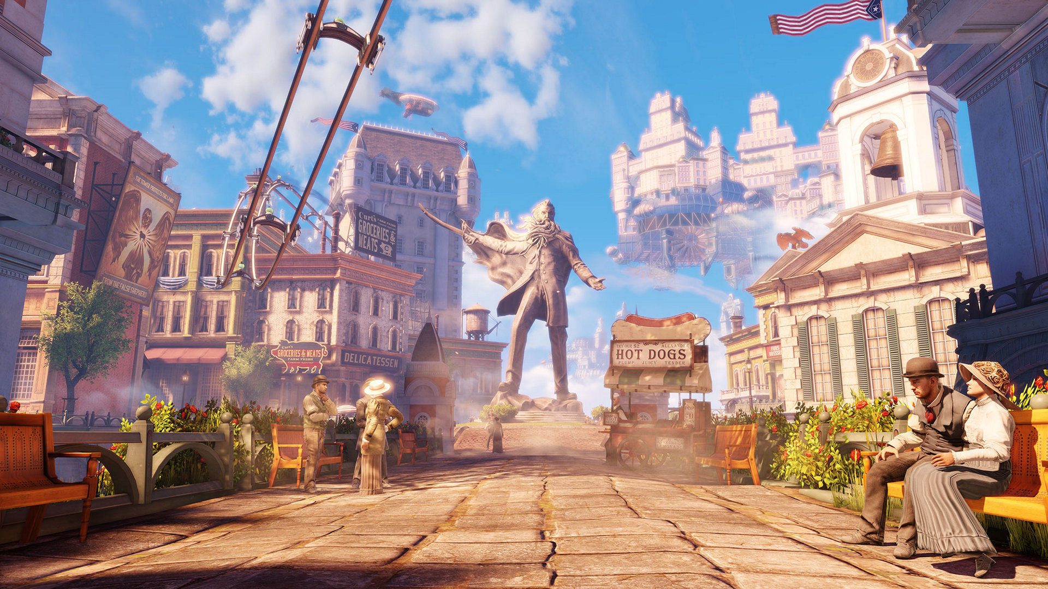

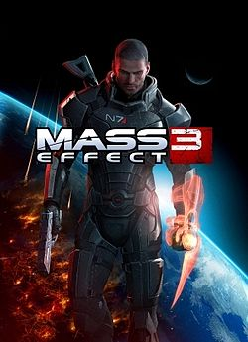
Multiplatform
Primarily 3D games
C++; Blueprint (node-based scripting)
Notes:
The current release is Unreal Engine 4, designed for Microsoft's DirectX 11 and 12^{[4]} (for Microsoft Windows, Xbox One, Windows RT); OpenGL (for OS X, Linux, PlayStation 4, iOS, Android, Ouya^{[5]}and Windows XP^{[6]}); and JavaScript/WebGL (for HTML5 Web browsers).^{[7][8][9]}

Slide 25
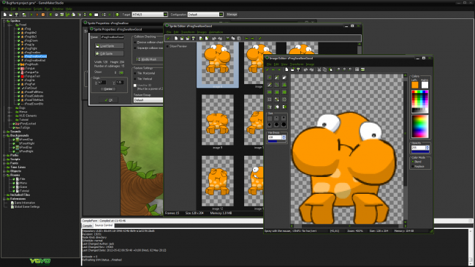


Additional Digital Game Tools
Game Maker
Processing

Slide 26


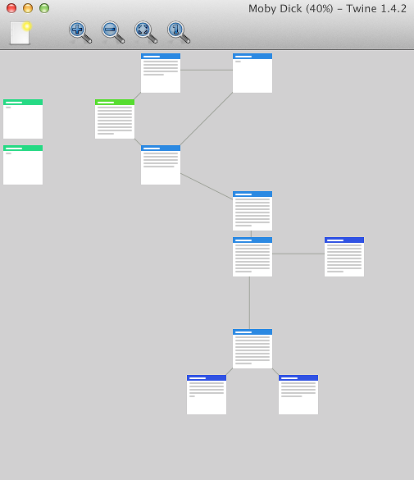


Additional Digital Game Tools
Flixel
HaxeFlixel
Twine
Phazer,p5.play
flash library
interactive fiction (text-based)
HTML5/Javascript Frameworks

Slide 27



OTHER FORMS
Physical Games
Board Games
Card Games
Notes:
dont discount traditional platforms
userful in understanding game design and core game mechanics without distractions
civ->risk

Slide 28
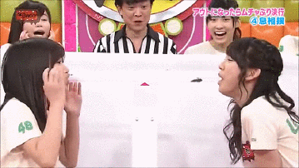

Slide 29
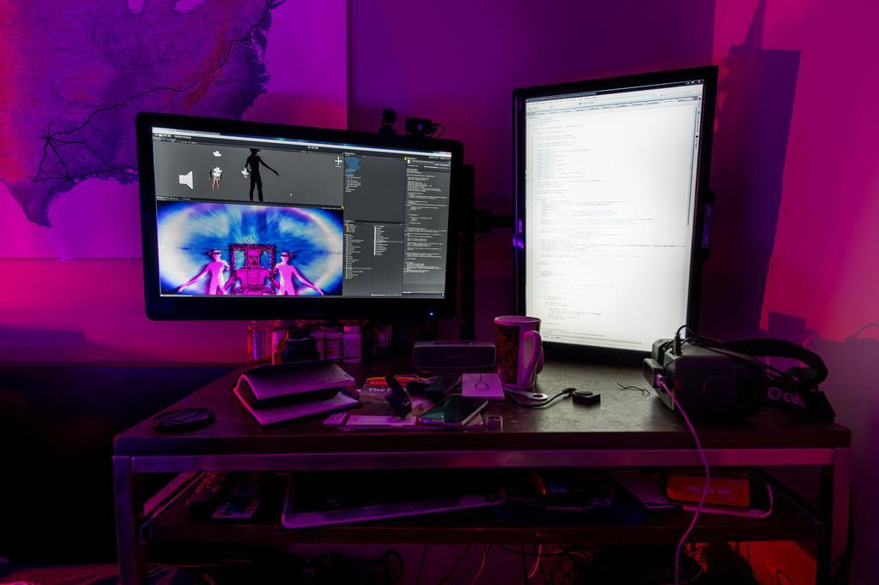
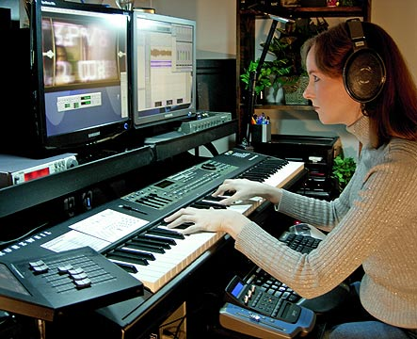

3.Production
implementation
programming
asset creation
Notes:
audio engineers get to work, graphic artists create art, programmers code, 3d artists model and animate

Slide 30
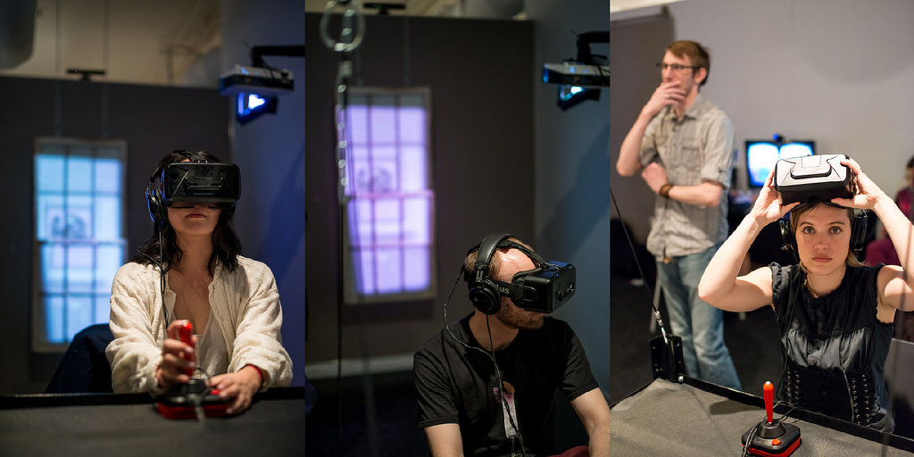
4. QUALITY ASSURANCE (QA)
Notes:
fixing technical problems like bugs, refining the art and models
building harmony between visual elements and controls, etc.

Slide 31
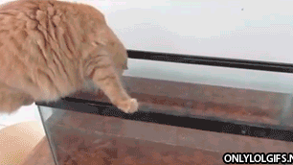
FORGOT TO PLAYTEST
UNTIL IT WAS TOO LATE
Notes:
if youre not playtesting, you dont know if it works

Slide 32
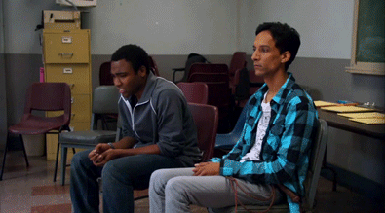
LET THEM PLAY!
Notes:
hard to wait. which parts are unclear, confusing
listen to them

Slide 33
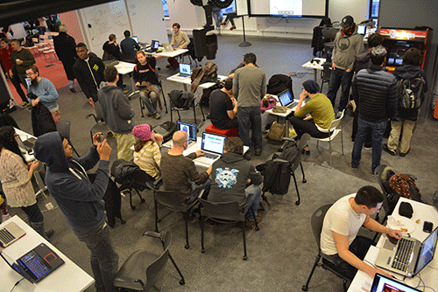
Additional Playtesting opportunities
NYCPlaytest (board games) - First Saturday of every month
http://masqueradegames.com/NYCPlaytest/wordpress/
Playtest Thursdays at NYU Game Center - Every Thursday 5-7pm
http://gamecenter.nyu.edu/events/playtest-thursdays/

Slide 34
Conceptualizing
Pre-production
Production
QA/Polish
What is it?
Why make it?
What makes it unique?
Which tools?
What skills/roles will you need? e.g. Graphic Artist, Programmer, etc.
If you lack the skills or personnel, how will you source assets?
Start exploring and creating prototypes
Implementation
Building overall game arch. and moving into details from there.
Fix technical problems, add finishing touches, effects
“tweaking variables”
review
Notes:
REVIEW

Slide 35
“I don’t have a fixed design process. Quite the contrary, I believe that starting from the same beginning will frequently lead to the same end. Finding new ways of working often leads to innovative designs.”
Reiner Knizia
(world’s most famous board game designer)
Notes:
...which means

Slide 36

jk
there are
no rules
Notes:
these are best practices, industry standards that work for most people
the smaller your team and project, the more flexibility you have

Slide 37
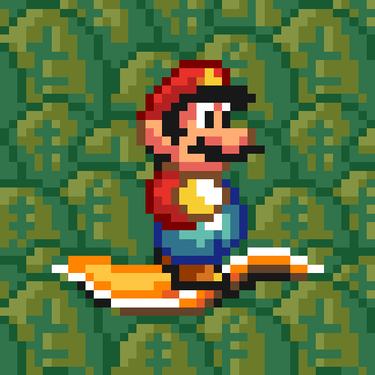
ASSIGNMENT
Reading:
RR1:
Rogers: Who Makes This Stuff?
Write a reaction paper to the reading. min one-page (approx. 300 words)

